Slide 1
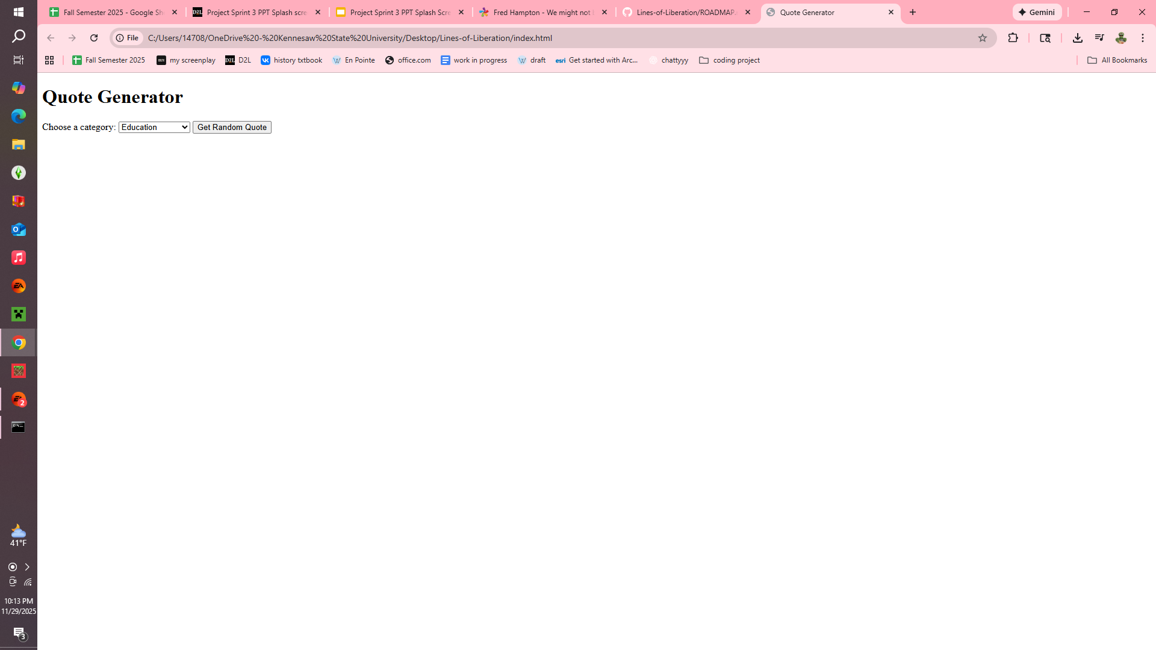
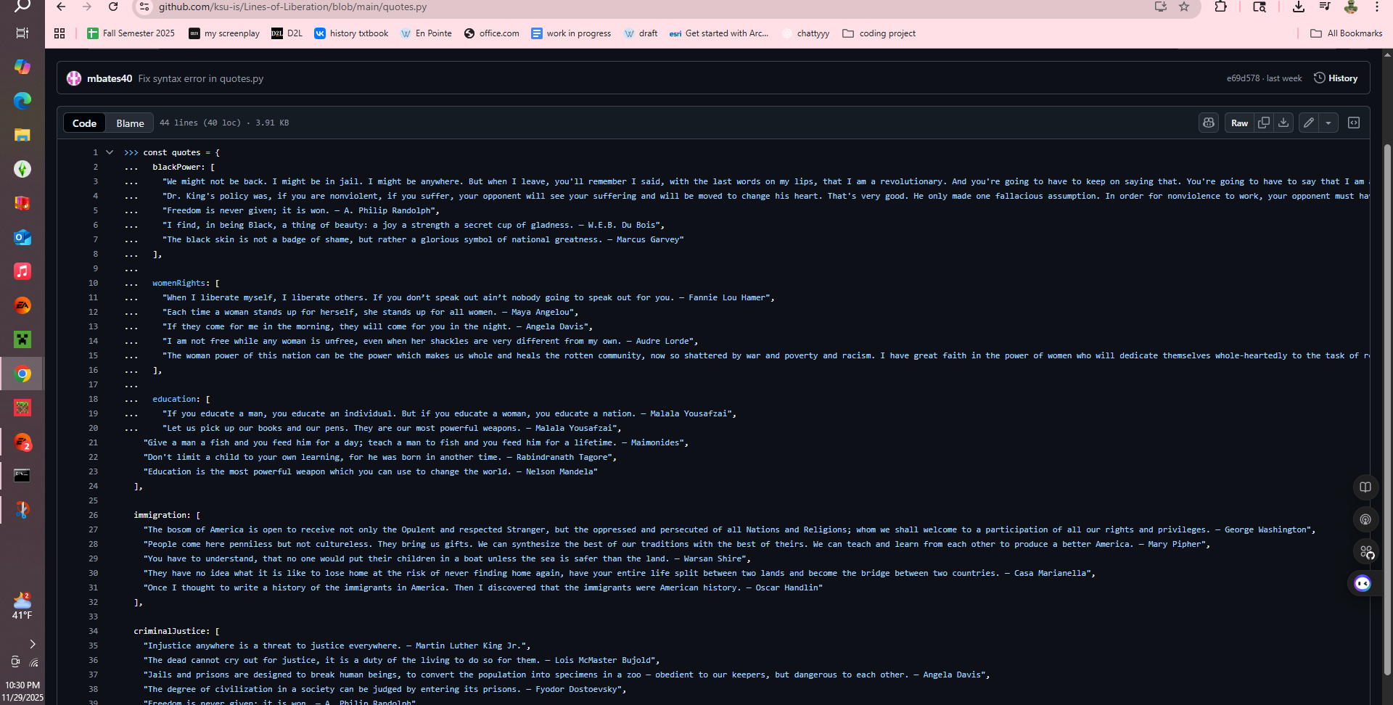
Lines of Liberation {
voices.html
liberation.css
[A quote generator that amplifies voices of liberation across five unique categories. Each designed to empower users with impactful messages]
< Members: Mia Bates >
}

